Slide 1

Dream Job
Matchmaker
Alyssia Oh
Notes:
Tinder, OKCupid, Coffee Meets Bagel, Grinder… at the time of COVID, Dating apps are becoming the new norm.
Which made me wonder, why aren’t there a website that can match you with your job?
Hi my name is Alyssia Oh, and this is the exact question I’ve faced with,
and decided to solve the problem myself, in hopes of making the upcoming task of job searching less stressful.

Slide 2
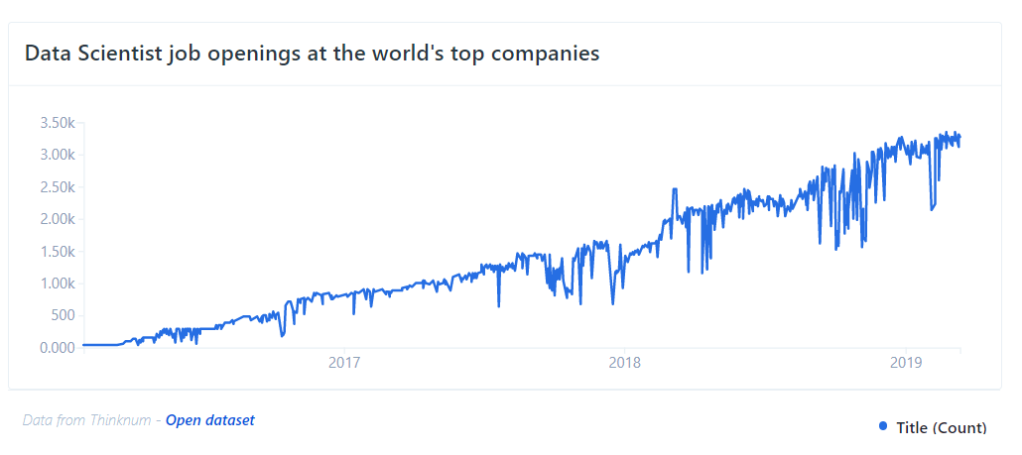
Background
2012
- Harvard Business Review named Data Scientist the “Sexiest Job of the 21st century”
2012-2019
- job openings skyrocketed by 650%
2025
– annual size of global datasphere projected to be 4X current size
Notes:
Luckily for data scientists around the world, the technology field is one of the few areas that had been least affected by the pandemic, and we still see the upward trending of data related jobs.
Since HBR named data scientist the seixest job of the 21st century, job openings skyrocketed by 650% by the end of 2019.
And this is only counting those titled ‘data scientist’, not counting data analyst, engineer, etc.
By 2025, the annual size of global datasphere is projected to grow to be 4x current size at 175 zettabytes that’s 175 trillion gigabytes.
”DATA is the new OIL” is the phrase I hear a lot, but unlike OIL, data grows exponentially.

Slide 3
Problem Statement
Can we optimize the job search process by automatically matching you to your ideal job? - can we automate the search? - how to minimize reviewing time? - what makes an ideal job ‘ideal?’ (salary, rating, skill-set match, location…)
Notes:
Which brings us back to the original question – in this gigantic ocean of data related jobs that are being posted everyday,
How do we find our dream job?
More specifically, can we automate this process?
How can we minimize reviewing time?
And lastly how do we define your dream job? Does it depend on salary? Company rating? Location?

Slide 4
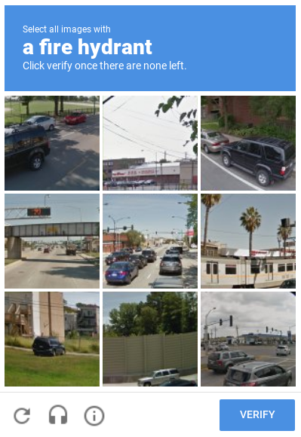
Automate Web Scraping from Job Aggregator Websites
Indeed = biggest job aggregator website
Glassdoor = provides rating, salary estimates, and other details
Company APIs no longer available for general public
Strict restrictions against web crawlers
Notes:
In terms of job aggregator websites, Indeed is by far the biggest job aggregator website, and most other job aggregator websites had too many overlaps with Indeed
Glassdoor is useful because they have the largest anonymous user reviews, and provide a lot more details such as rating or salary estimates.
They both have company APIs, but unfortunately those are no longer available for genera public
And they have quite strict restrictions against web crawlers and often have very difficult ‘are you a human’ puzzles such as this one.
At one time, I failed three times

Slide 5
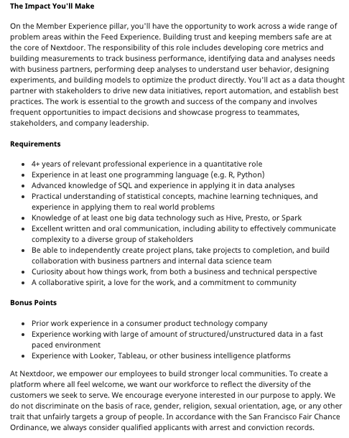
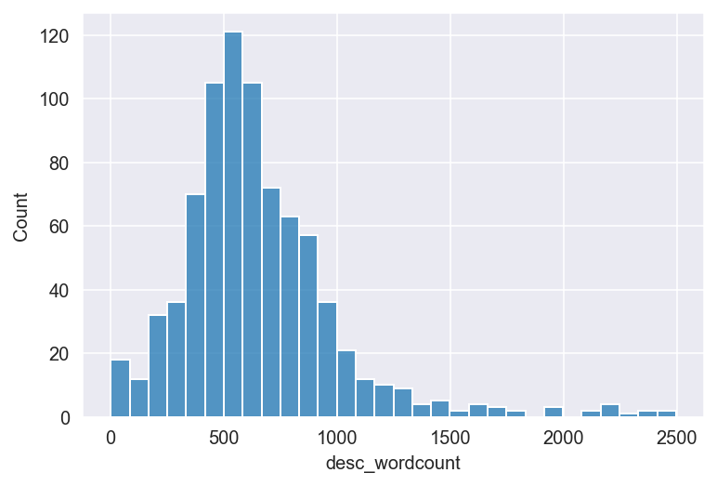
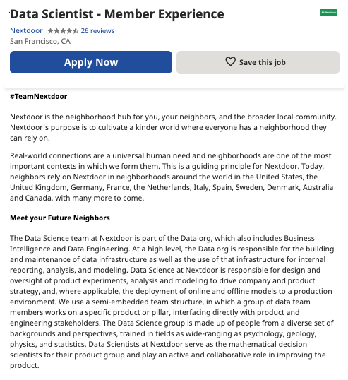
Job Descriptions are Overwhelmingly Long and Detailed
Average Word Count = 650 words
100 jobs/day = 250 pages
= length of non-fiction novel
Notes:
After some search, I realized that job descriptions are unusually long and detailed, averaging at around 650 words per job.
If you browse 100 jobs a day, that’s equal to about 250 pages, which is the average length of non-fiction novel!

Slide 6
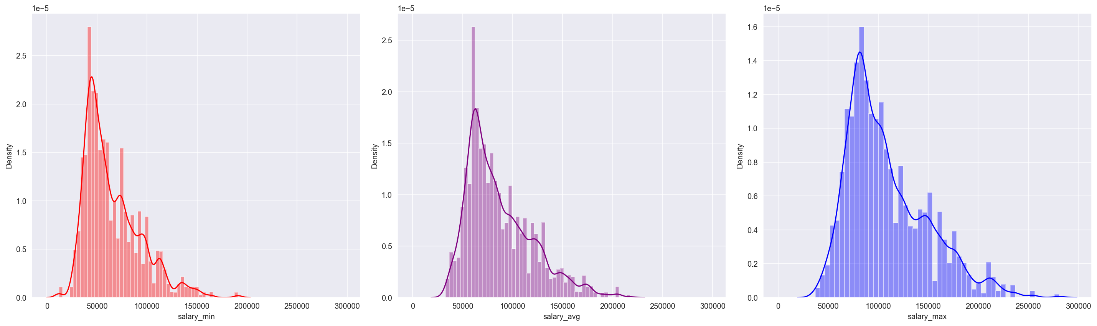
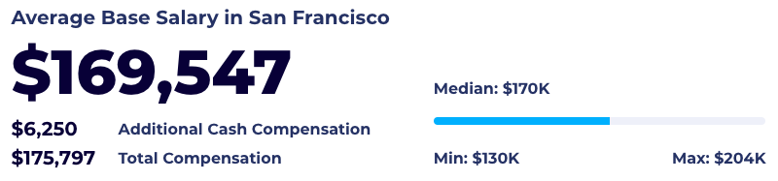
Salary Estimate is Highly Variable within ‘DATA’ related jobs
avg. minimum = $65K
Average = $87K
avg. maximum = $110K
Data Scientist base salary in San Francisco
= $130-$200
(data from bullinSF)
Notes:
Another challenge is the variability within the salary estimate.
This is based on 12000 data-related jobs, and the average minimum salary is barely over half of the average maximum salary
Even among data related jobs, there is a big variability as data scientist base salary in SF ranges between 130-200

Slide 7
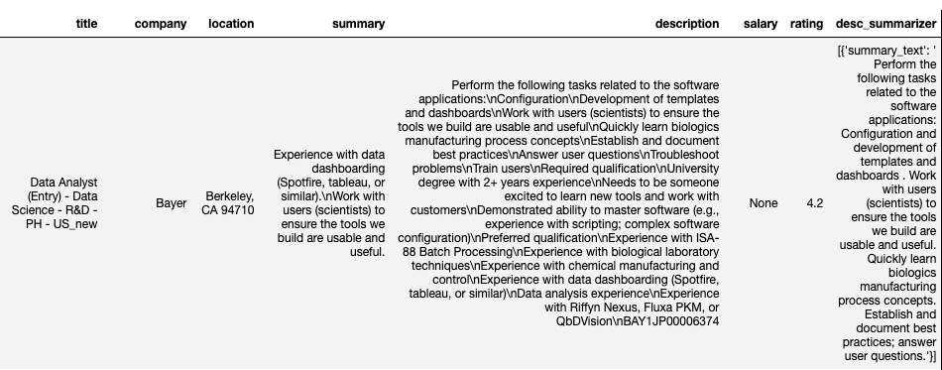
Automate Web Scraping – using bs4 / requests
Set desired frequencies for scraping – script will automatically generate a data frame and export as a csv file
Avoid IP-blacklisting by using rotating VPN / dynamic time changing and limiting the number of requests within a given time frame
Average = $87K
Notes:
So how can we deal with these challenges?
Well, it wasn’t easy
But I was able to use in-house script that you can set at your desired frequency to automatically generate a data frame and deliver as a csv file
To avoid getting your IP address blocked, I ended up using rotating VPN, but if that is not an option, you can get around the issue by slowing the time between each request and limiting the number. Indeed usually blocked the request after 10 pages.
So at the end, it isn’t easy but doable.

Slide 8
Lengthy Job Description –
BART-based transformers summarization model
Summary Text:
Perform the following tasks related to the software applications: Configuration and development of templates and dashboards. Work with users (scientists) to ensure the tools we build are usable and useful. Quickly learn biologics manufacturing process concepts. Establish and document best practices; answer user questions.
650 words
40 words
Notes:
Second, the problem with length job description
After the scraping, I quickly realized that the file size was extremely large for the number of job postings scraped, and the description on the left is just the top of the description.
To solve this problem, I used BART-based transformers summarization model, which summarized 650 words document, down to about 40 words.
Importantly, the summary works pretty well. I initially looked into various ways of extracting keywords of importance, but with the length of description, it was extremely difficult to find how to quantifying it.

Slide 9
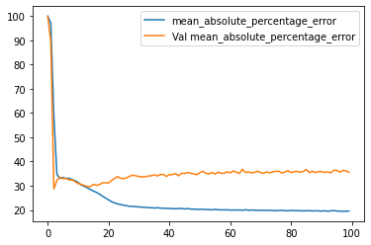
Salary / Rating Estimate –
… are they useful metrics for job search?
Models Tested:
Linear Regression
CVEC / TFIDF regression
Lasso / Ridge regression
Neural Network regression
NLP Convolutional Neural Network
NLP Recurrent Neural Network (interrupted due to training time)
Either too good to be true or worse than the null model
Size of the training set?
NLP CNN = mean 33% error predicting average
(using >15000 row dataset for training)
Notes:
The biggest challenge, was salary and rating estimate
Which made me wonder, are they useful metrics for job search?
These are all the different type of models I’ve tested, including the NLP CNN model shown on the right, were either too good to be true or worse than the null model
At first, I wondered if the training set was too small, but even after using a large training dataset, the mean error for predicting the average salary plateaus at 33%

Slide 10



Salary / Rating Estimate –
… are they useful metrics for job search? Probably not
Notes:
Well, the problem is, the models are bad at predicting the mean salary, but almost every prediction falls within the minimum and maximum salary data!
So even though 8/10 job searchers consider salary to be an important factor in deciding the job, they may not be the most useful metrics for job search.
Then, what can I use to measure my ideal job?

Slide 11
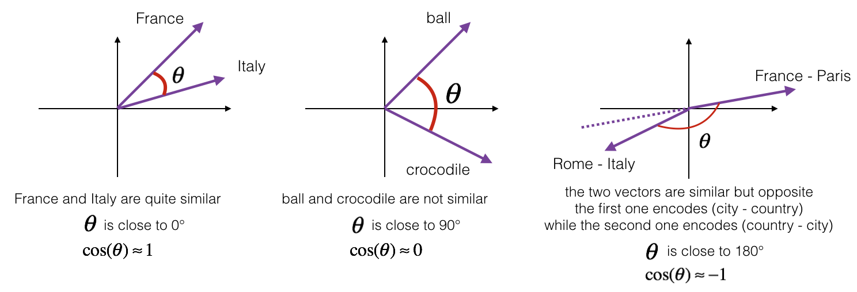
Better metric = CountVectorizer Cosine Similarity
Notes:
Better metric for seems to be CountVectorizer cosine similarity. Instead of screening for exact keyword match,
It looks at how closely words relate to each other. For example, France and Italy will have high cosine similarity score, whereas you add the state capitals, as Rome Italty and Paris, France, they are similar but are opposite at cosine similarity of -1.

Slide 12
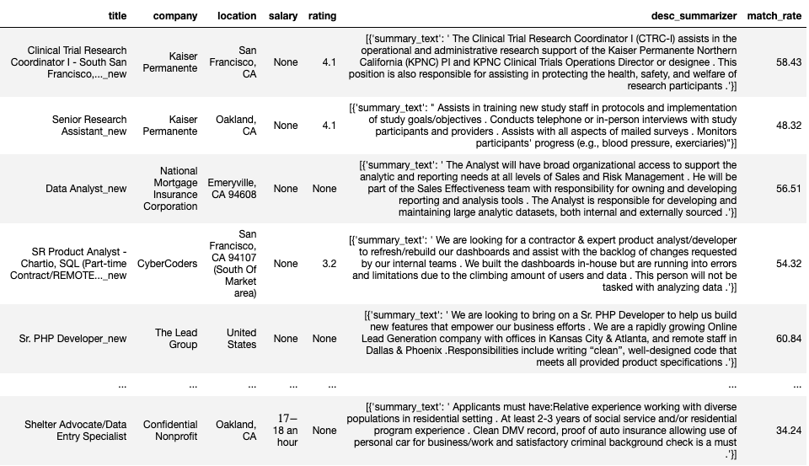
You’ve got a match!
Notes:
The final product

Slide 13
Automate generating ATS resume based on data frame
User-friendly web interface
More data to keep training the models for any improvement
Conclusion / Future Plans

